Slide 1
Kiosk Ordering App
PEAZA

Slide 2
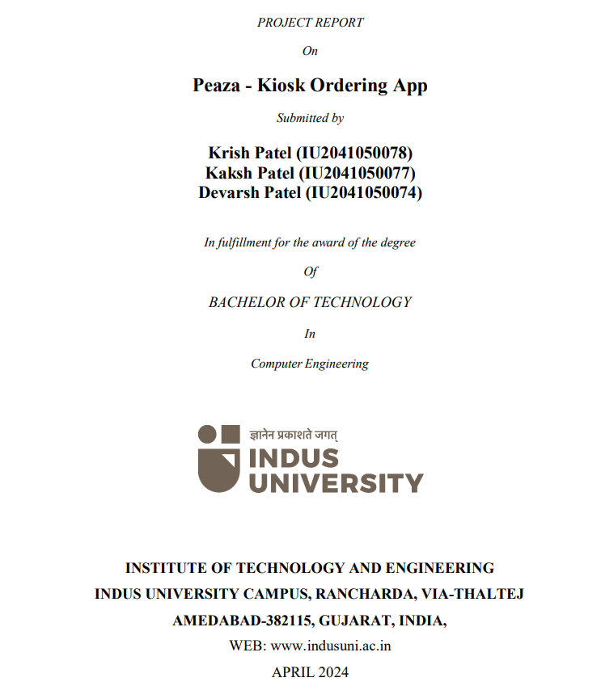

Slide 3
Introduction
Peaza revolutionizes the restaurant experience, offering a user-friendly web platform for pizza ordering. With its intuitive interface, customers easily explore a diverse menu with detailed pricing. The customization feature allows users to personalize their orders, from toppings to base, sauce, and cheese, catering to individual preferences and dietary needs.
Peaza stands out as a comprehensive, customer-centric platform, simplifying the ordering process and enhancing satisfaction. By providing extensive information and customization options, Peaza ensures every order is tailored to meet the unique desires of each customer

Slide 4
Why an Online system for Pizza ordering was needed?
Online Ordering System:
Eliminates miscommunication associated with phone orders.
Provides a visual menu for a hassle-free selection process.
Efficiency Improvement:
Reduces overall purchasing time for customers.
Allows customers to place orders in advance through a mobile/web app.
Convenience Enhancement:
improving overall convenience of customers for smooth ordering.
Competitive Advantage:
Incorporating internet technology provides a competitive edge in the market.
Contributes to improved and efficient services for the pizzeria.

Slide 5
Objectives of Online Pizza Ordering System
Customized Pizza Selection: Facilitating customers to build their own pizzas, allowing them to choose specific ingredients according to their preferences. This customization feature aims to elevate the pizzeria's image and enhance overall customer satisfaction.
Order Confirmation and Details: Furnishing customers with comprehensive details of their order before finalizing the purchase. This confirmation step empowers customers to review selected items along with their respective prices, ensuring transparency in the ordering process.

Slide 6
Objectives of Online Pizza Ordering System
Paperwork Reduction: Minimizing the reliance on paper by transitioning various aspects of the ordering process to an online platform. This not only aligns with environmental considerations but also contributes to a more efficient and organized system.
Online Payment Option: Providing customers with the convenience of making cash-free transactions through online payment methods. This not only streamlines the pizza purchasing process but also aligns with modern payment preferences.
In summary, the online pizza ordering system aims to provide a tailored and efficient experience for customers while concurrently optimizing operational aspects for the pizzeria.

Slide 7
How this system works
Store Login :
Store Login Information
Menu Display:
Menu with pizzas and other products displayed.
Ingredients listed with respective prices.
Pizza Customization:
Customer customizes the pizza, adjusting ingredients and selecting quantities.

Slide 8
How this system works
Payment Options:
Selects online payment method(Net-banking, wallets ,cards).
Order Confirmation:
Order is placed, and customer receives notification.
This flow ensures a seamless and user-friendly experience for customers when ordering from the pizzeria’s kiosk.

Slide 9
Tools and Technology
Frontend : HTML5, CSS3, JavaScript, ReactJS, Redux, MUI
Backend : NodeJS, Express JS
Database : MongoDB

Slide 10
Future Enhancement
In the near future, we'll transform online food ordering by
integrating advanced software solutions. These will enhance user interaction through intuitive interfaces and cutting-edge algorithms. Expanded facilities will cater to diverse preferences, offering personalized recommendations and interactive menus.
At checkout, customers can choose takeaway or dine-in options, with automatic table assignments for seamless processing. Our discount and coupon options will enhance affordability and loyalty, with dynamic promotions and hassle-free redemption, ensuring an unmatched dining experience.

Slide 11
Conclusion
This project is poised to be a robust solution, seamlessly meeting customer needs. It will streamline ordering at kiosks, reducing wait times. Its intuitive interface and efficient features will enhance user experience, ensuring prompt service. This innovative system will transform ordering, making dining more convenient and enjoyable at restaurants.

Slide 12
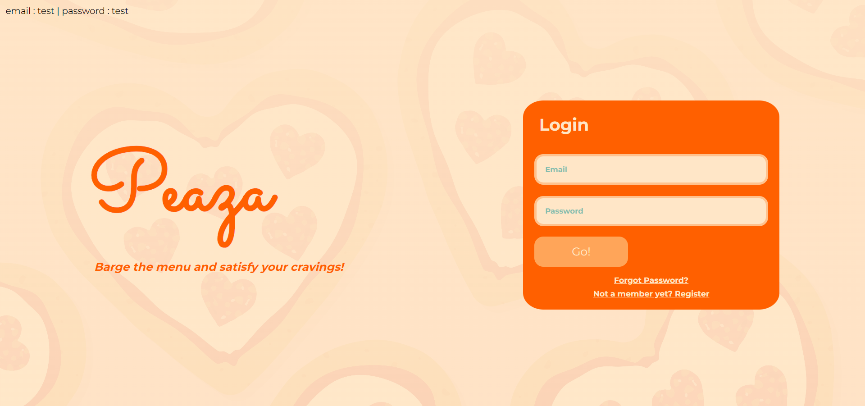
Store Login Page

Slide 13
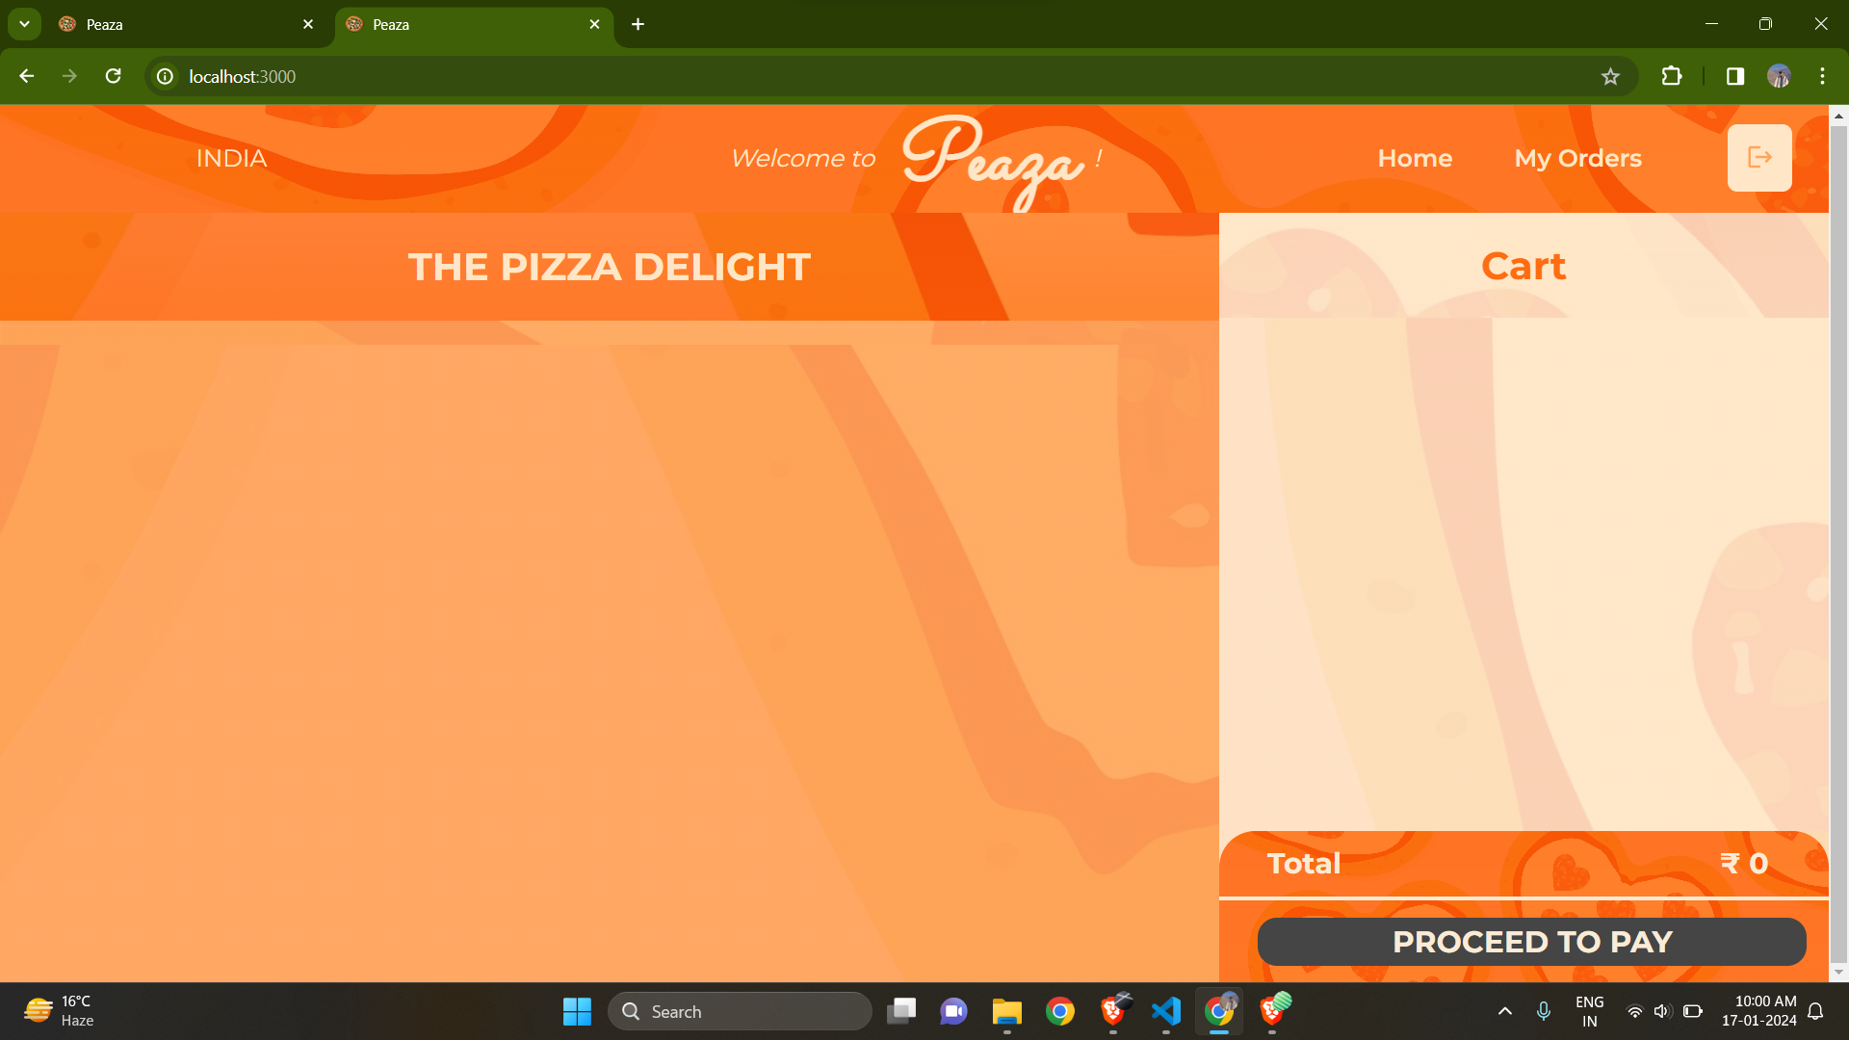
Abstract site layout
A basic website layout which is easy to Understand and Navigate for end user.

Slide 14
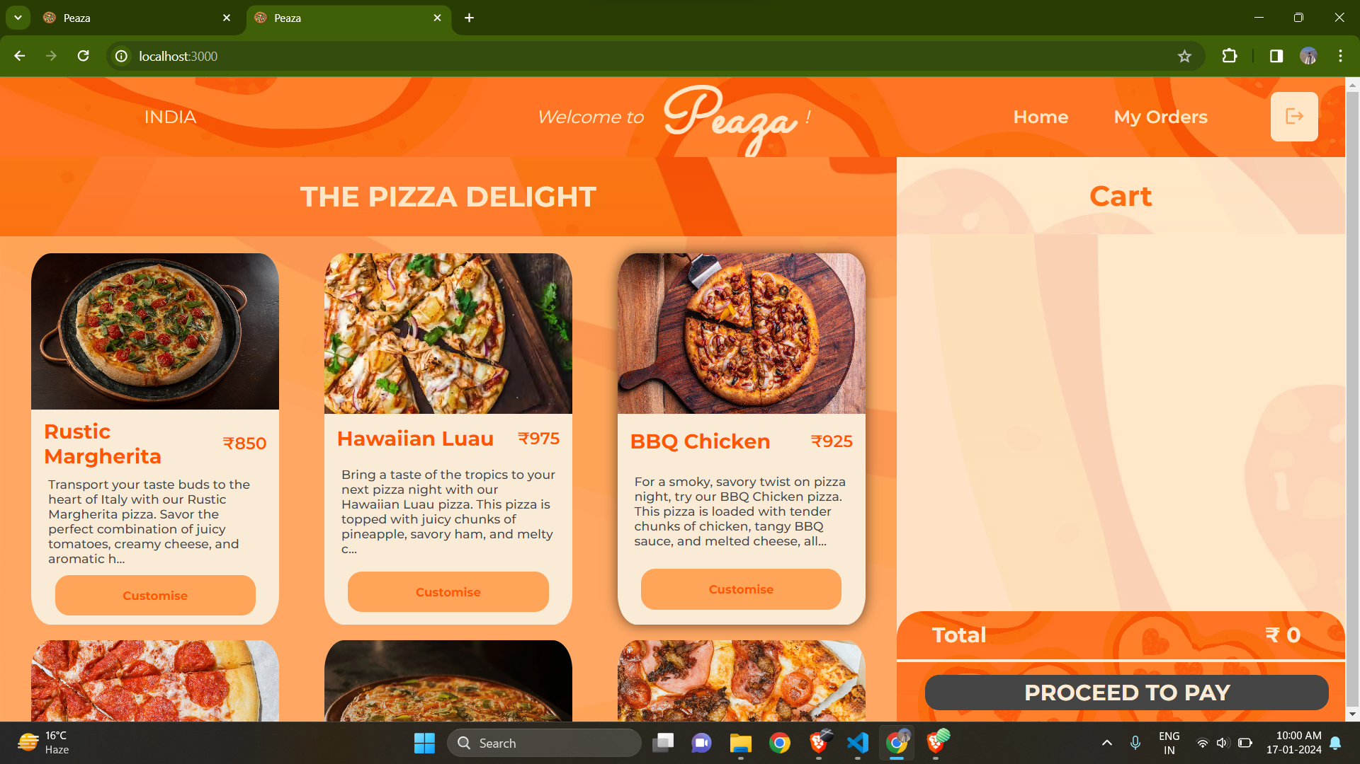
Menu layout
Menu with pizzas displayed with a tempting description of each pizzas with associated price.

Slide 15
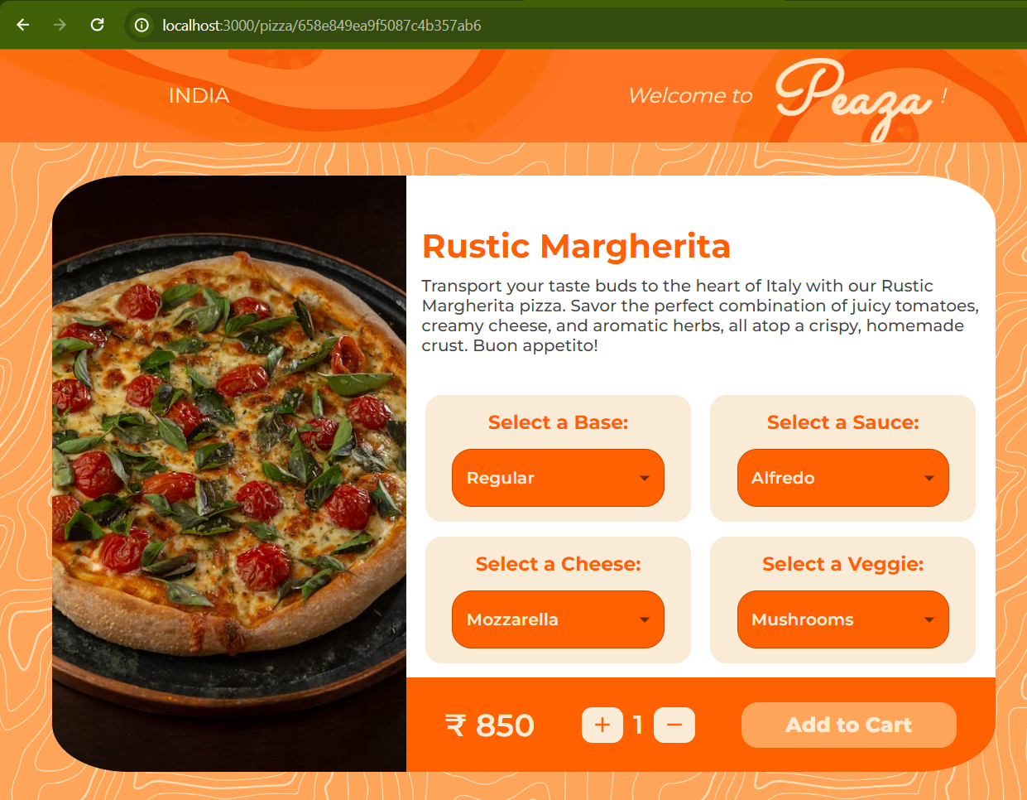
Pizza tab layout
An individual pizza with customization options such as base, sauces, cheese, and veggies.

Slide 16
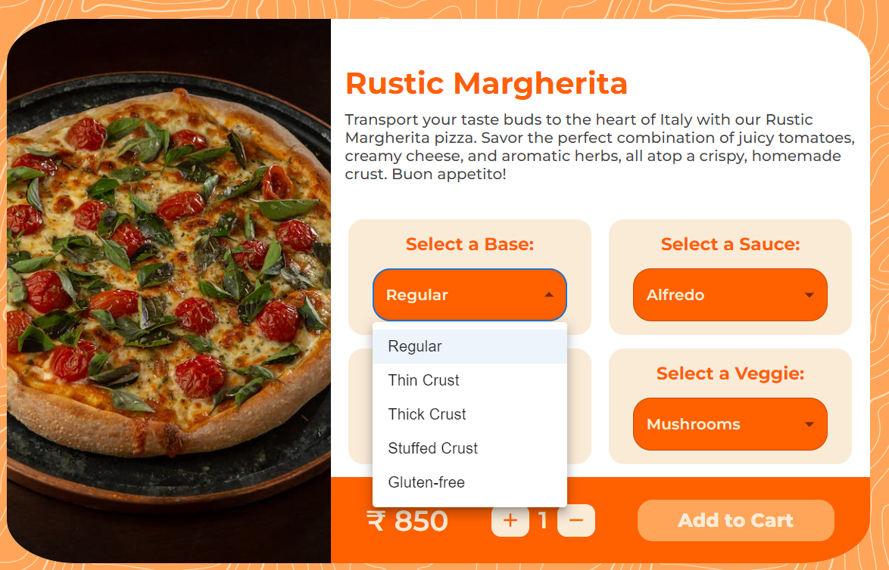
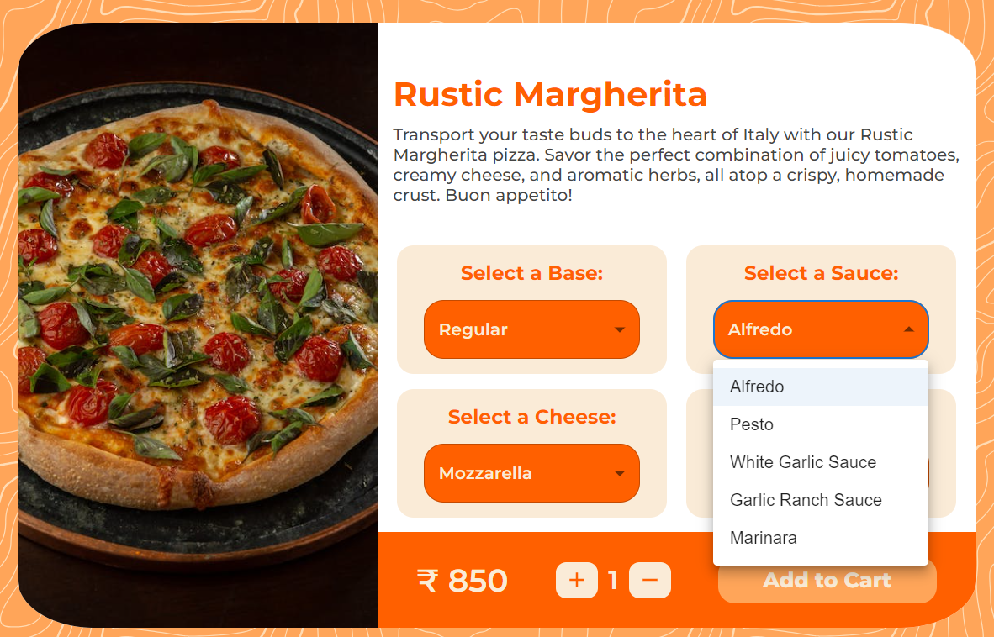
Customization Page
Here, we have added different types of Base and Sauce. One can choose according to their choice.

Slide 17
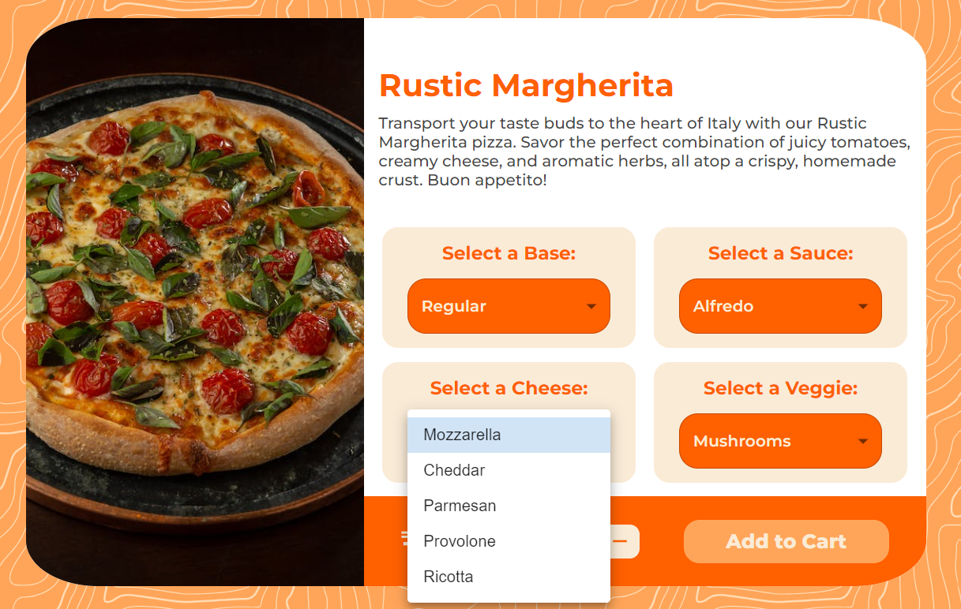
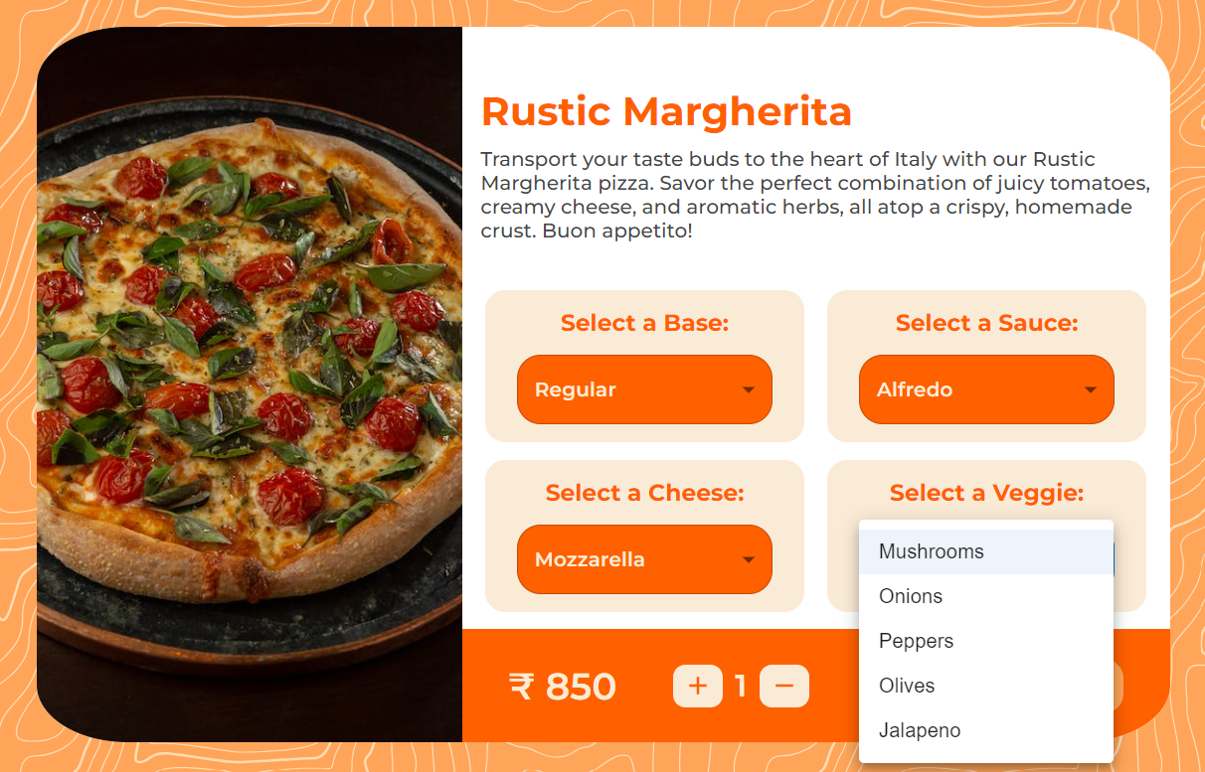
Customization Page
We have also included many kinds of Cheese and Veggie. One is free to make their own decisions.

Slide 18
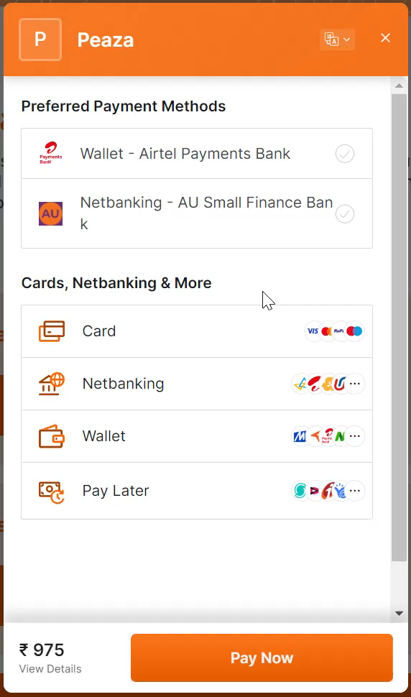
Payment Gateway
We have used Razorpay payment gateway for smooth, convenient and secure transactions.
This include multiple payment options such as card, netbanking, wallet and pay later.

Slide 19
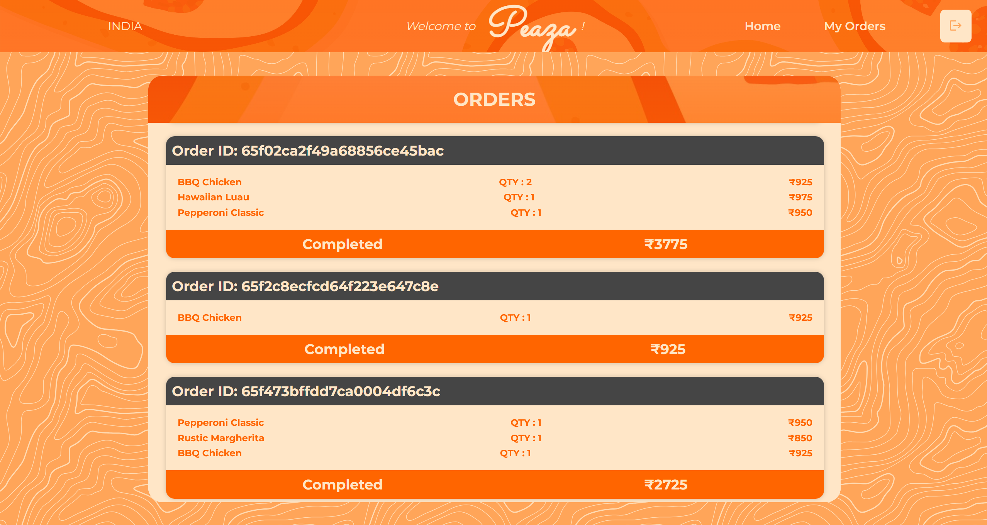
My Orders
This page shows all previous orders.
Each order has its own Unique Order ID and completion status.

Slide 20
Our Team
Krish Patel
Kaksh Patel
Devarsh Patel
IU2041050078
IU2041050077
IU2041050074

